Slide 1
Integrating Azure ML with Power BI

Slide 2
Agenda
Introduction
ML Terminology
Azure ML overview
Power BI overview
Demo

Slide 3




Michael Huffer
Senior Data Analytics Consultant at DMI
Bachelors Degree in Applied Mathematics from Franklin College
Masters Degree in Statistics from Ball State University
Avid Chicago Bears fan
Email: mdhuffer299@gmail.com
GitHub: https://github.com/mdhuffer299
LinkedIn: https://www.linkedin.com/in/michael-huffer-8664086a

Slide 4
Machine Learning terminology
Machine Learning
Presenting carefully curated data to computer algorithms that find patterns and systematically generate models (formulas and rule sets).
Data Science
Field of study that uses scientific methods, processes, algorithms and systems to extract knowledge and insights from data in various forms, both structured and unstructured.
Algorithm
Mathematical formula for solving a specific problem, based on conducting a sequence of specified actions.
Model
Output of mathematical formula (algorithm) that represents a pattern in the input data, that can then be applied to new data that has been provided in the same format.

Slide 5
Machine Learning terminology
Supervised Machine
Learning
Algorithms applied to a dataset that contains an identifiable “label” variable with multiple feature variables that generates a model.
Unsupervised Machine
Learning
Algorithms applied to a dataset that searches for homogenous subsets and produces one or more possible segmentations of the data that differ by a degree of similarity.
Label
Clearly defined and known outcome of a dataset stored in a single variable that represents the goal of the modeling process.
Features
Variables recorded in the dataset that are used to generate the models prediction. Must also be available in new data.

Slide 6
Azure machine learning studio

Slide 7
What is Azure Machine Learning studio?
Microsoft Azure Machine Learning Studio is a collaborative, drag-and-drop tool you can use to build, test, and deploy predictive analytics solutions on your data. Machine Learning Studio publishes models as web services that can easily be consumed by custom apps or BI tools such as Excel.
- Microsoft

Slide 8
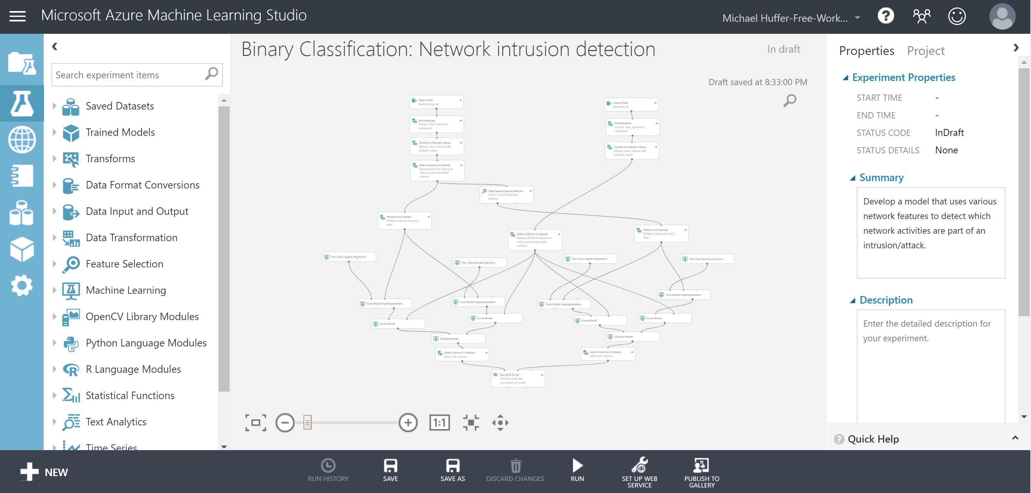
Azure Machine Learning workspace
Project Navigation Menu
Experiment Canvas
Module Menu
Module Properties
Experiment Menu

Slide 9
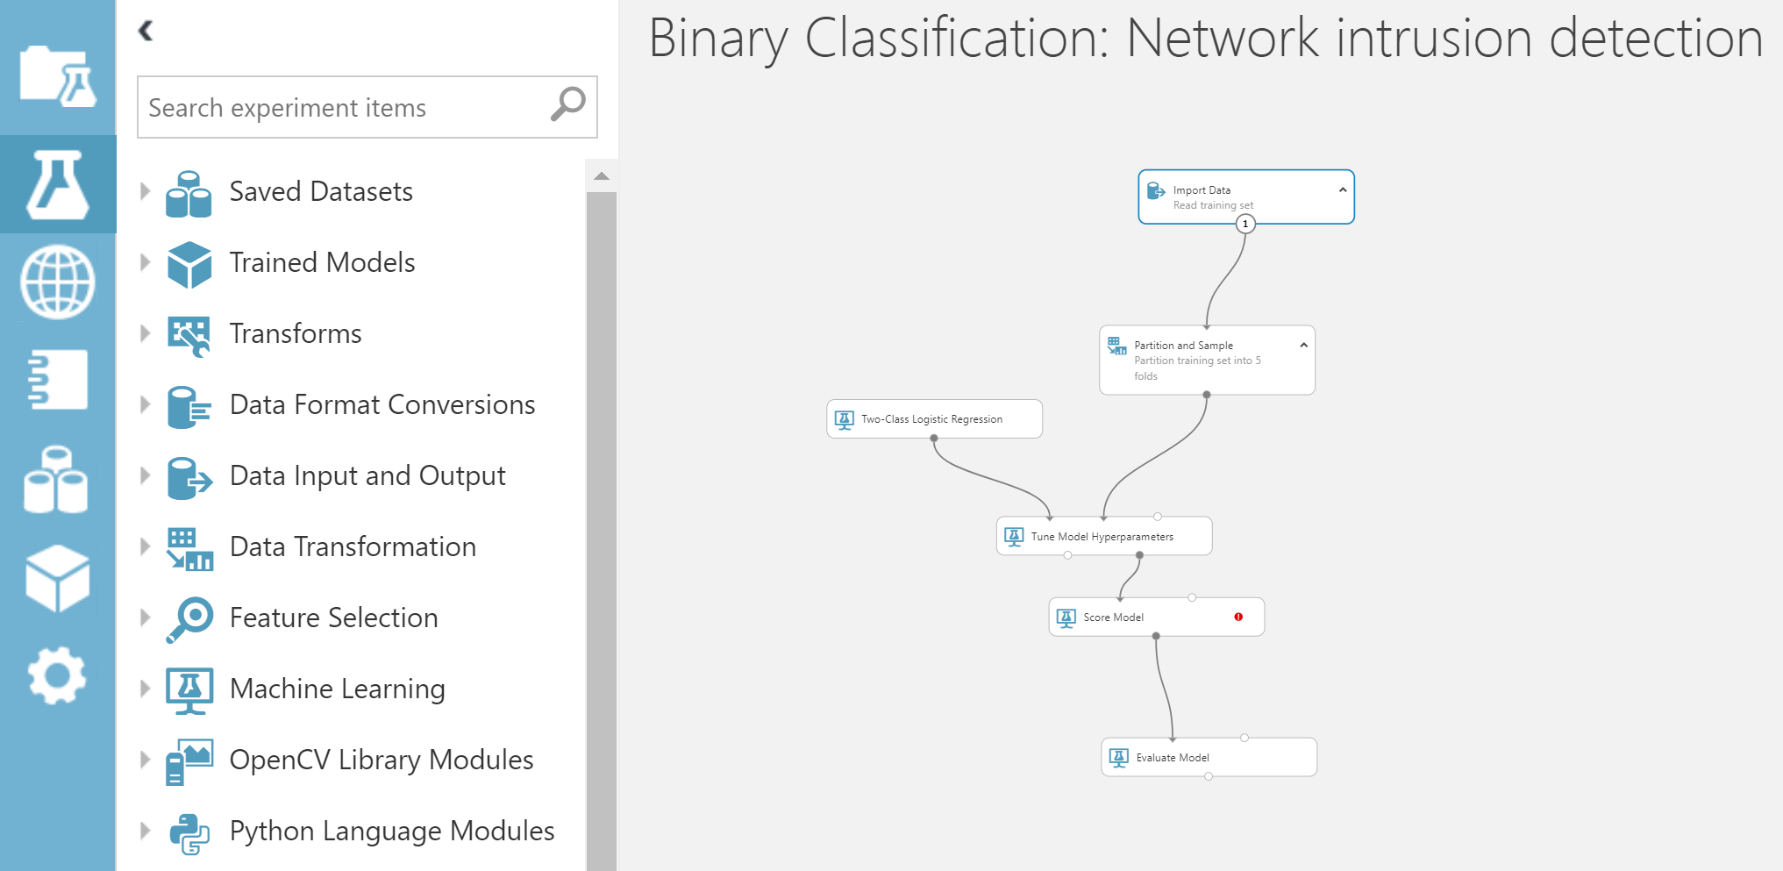
Azure ML experiments
Data Preparation
Data Imports
Exploratory Data Analysis
Data Transformations
Model Creation
Algorithm Selection
Split
Train
Score
Evaluate
Operationalize

Slide 10
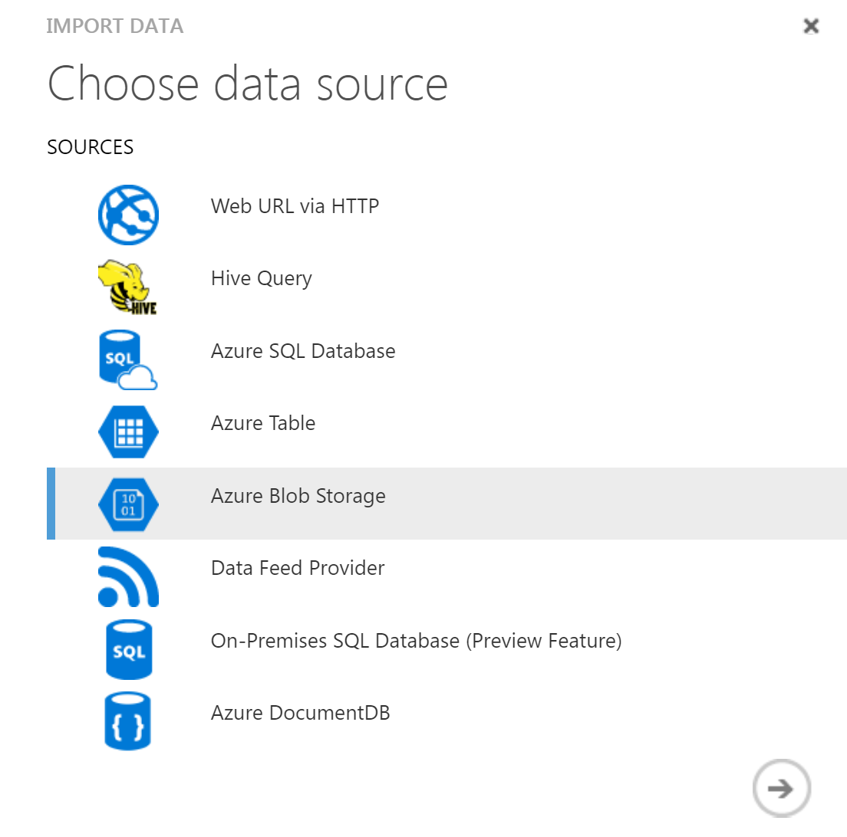
Import data to Azure Machine learning
Azure Blob Storage
Azure SQL DB
Hive Query
Website
On-premise SQL Server

Slide 11
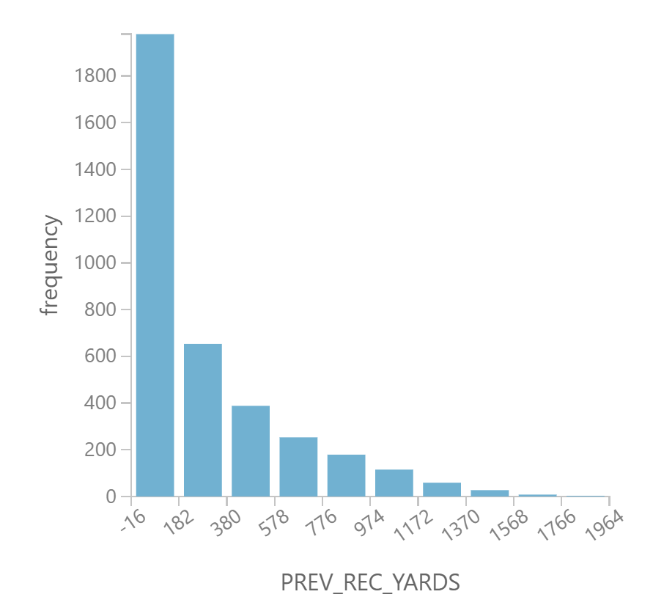
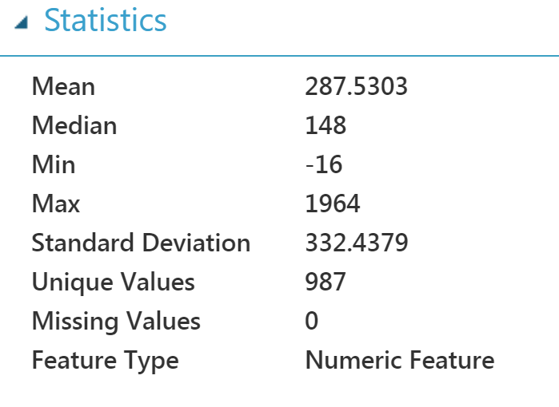
Explore and Summarize data
Univariate summaries
Create
Visualize
Multivariate summaries
Create
Visualize
Custom Visualizations
R
Python
Notes:
This is an important step in any data analysis but when you are building out predictive models, this is always the first step. Exploring the data helps you understand exactly what data you have available and helps you determine which features need to be removed or combined. You can easily see the distribution of the data and determine if any normalization is needed.

Slide 12
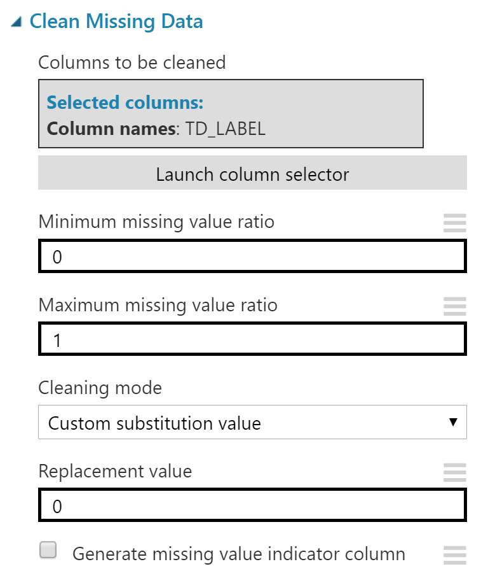
Cleanse data for Azure Machine learning
Missing data
Outliers
Remove columns or rows
Notes:
Outliers: Important to evaluate and understand the ramifications of removing outliers from your data set. These could be interesting nuggets of information needed in your model.

Slide 13
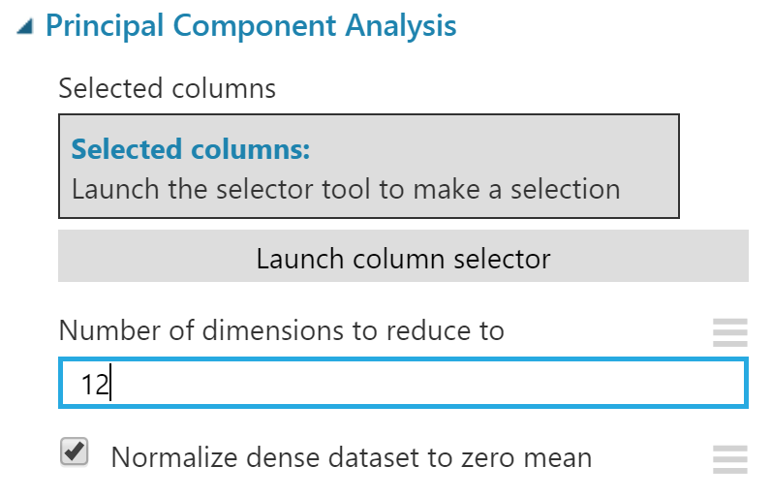
Perform Feature engineering
Merge data
By columns
By rows
Manually create new features
Automatically create new features
Manage variable metadata
Standardization
Notes:
This is important as you can build new features that could drastically improve your models performance.
Leverage knowledge gained through the exploratory data analysis phase to build valuable features.
Important that features represent some sort of change over a period of time, static features do not help determine what is influential in predicting a label.
Important to think about what features you have available during model scoring. If a feature does not get captured until after the outcome needs to be determined, it is not useful in the model.

Slide 14
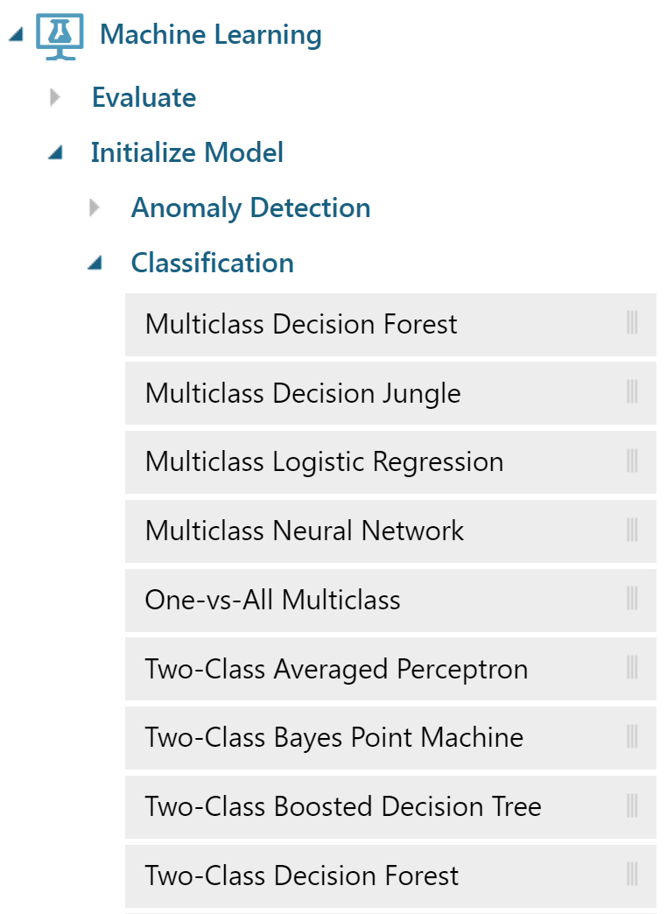
Available algorithms
Classification
16 available algorithms
Regression
8 available algorithms
Clustering
1 available algorithm
Recommender
1 available algorithm
Custom
R or Python Machine learning algorithms
Notes:
Most of the time, a classification algorithm will be what you are looking to use in most machine learning experiments. More specific examples of object recognition and text analysis will use deep learning practices and will need to leverage a different platform.
Classification
9 Two-Class (e.g. Two-Class Boosted Decision Tree)
5 Multiclass (e.g. Multiclass Neural Network)
2 Anomaly detections (e.g. One-Class SVM)

Slide 15
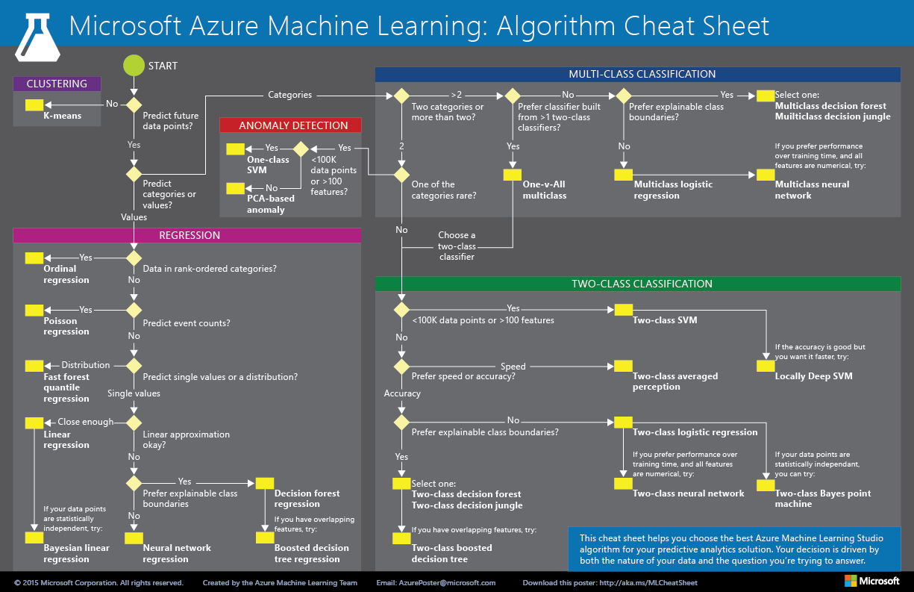
appropriate algorithm for the problem
Notes:
This decision tree will help you determine what algorithm is appropriate for your problem.
Want to keep in mind what is the actionable outcome and the associated process once a model has actually scored your data. In other words, what do I want to do once I have a prediction. Does the prediction notify someone, does it shut down and assembly line, etc…

Slide 16
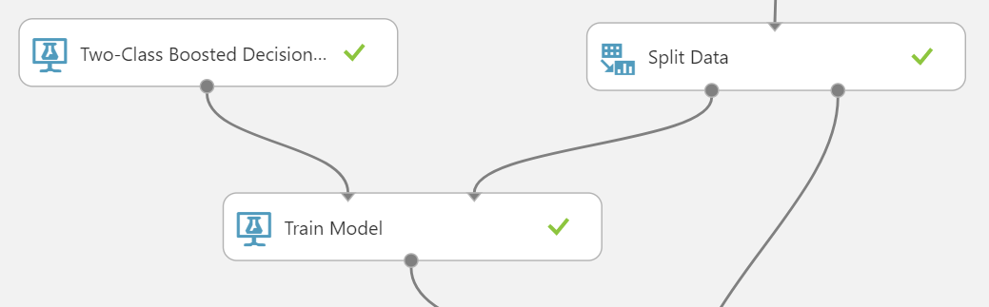
Initialize and train your model
Split data
Training
Test
Should represent your population
Should be balanced
Tune hyperparameters
Manually
Automatically
Cross-validation
Notes:
Important to split the data appropriately for you model. Need to make sure there that your training and test data splits are representative of your population. Also need to have the train and test split be balanced.
For example, if there is an anomaly that is happening 1 out of 100 cases. You have a 1000 records in your train set and 100 records in your test set. You would want to keep the ratio even in each set of data. The train set would need to have 10 anomalies while the test would have 1 anomaly.
Holding back a certain number of “folds” of the data during the training phase to help determine how your model will handle data that it has never seen before. Helps to combat overfitting of your data.

Slide 17
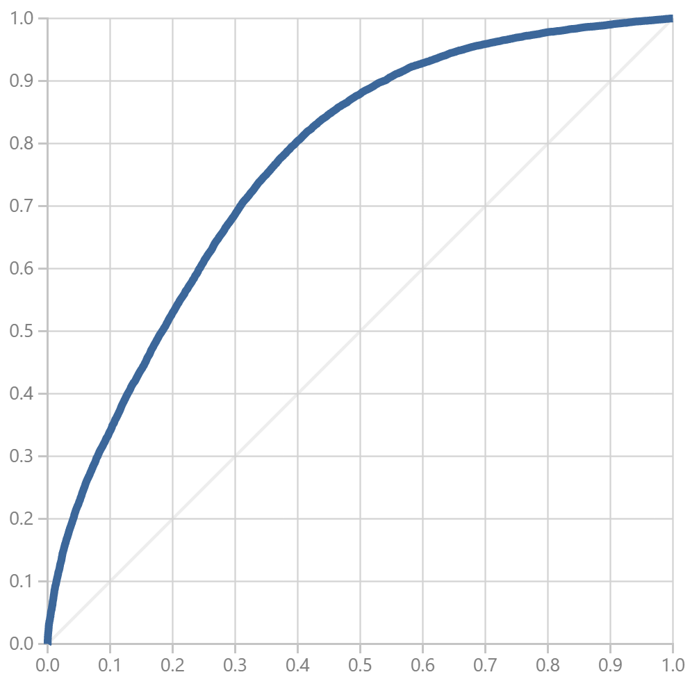
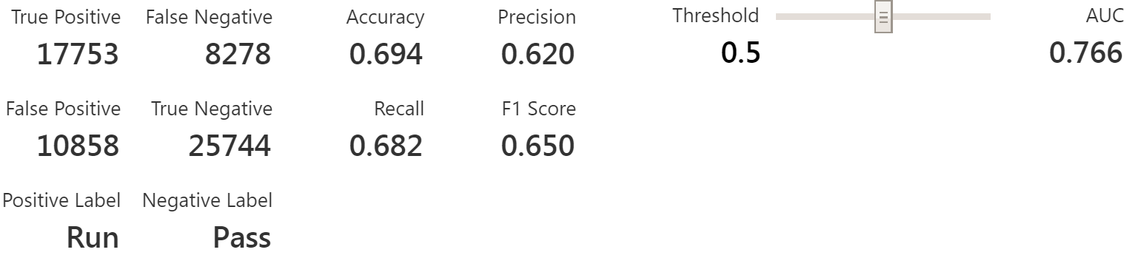
Validate your model
Score and evaluate models
Select appropriate evaluation methods for algorithm
Clustering
Classification
Regression
Comparison of models
Notes:
Once you have decided how you are going to evaluate your model, you want to stick with this validation metric while you are comparing multiple models. It allows you and others who wish to replicate your experiment validate their models accuracy against yours.

Slide 18
Model Consumption methods
Out of the box APIs available.
Request/Response
Batch
Languages provided:
C#
Python
R
Notes:
Azure ML provides easy to use web services that allow you to easily integrate and operationalize your predictive model out to you business users.
Provides you with about 80% of the code you need to start consuming the web service.

Slide 19


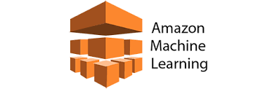
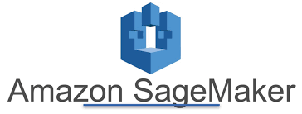

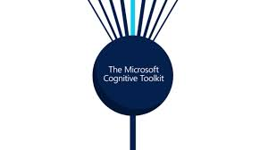

Other tools for Machine learning
HD insight
Spark
R Server
SQL Server 2016/2017
R Services - 2016
ML Services – 2017
Azure ML workbench
Amazon Machine Learning
Amazon Sage Maker
Databricks
Microsoft Cognitive Toolkit
Notes:
HD insight (SPARK/R Server)
SQL Server 2016/2017 (R services/ML services)
Azure ML workbench
Amazon Machine Learning/Amazon Sage Maker

Slide 20
Power Bi overview

Slide 21
What is Power BI?
Power BI is a business analytics solution that lets you visualize your data and share insights across your organization, or embed them in your app or website. Connect to hundreds of data sources and bring your data to life with live dashboards and reports.
- Microsoft

Slide 22





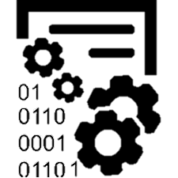
Common workflow in power bi
Sources
Power BI Desktop
Power BI Service
Data Modeling
Reporting
Databases
End Users
Publish
Files
Notes:
Maybe use a cloud icon for PBI Service?

Slide 23
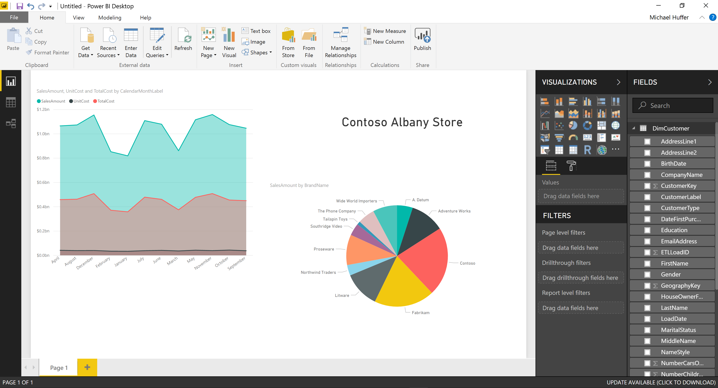
Power bi desktop
Report View
Data View
Relationship View
Visualizations available
Workspace Canvas
Data Available:
Tables
Attributes

Slide 24
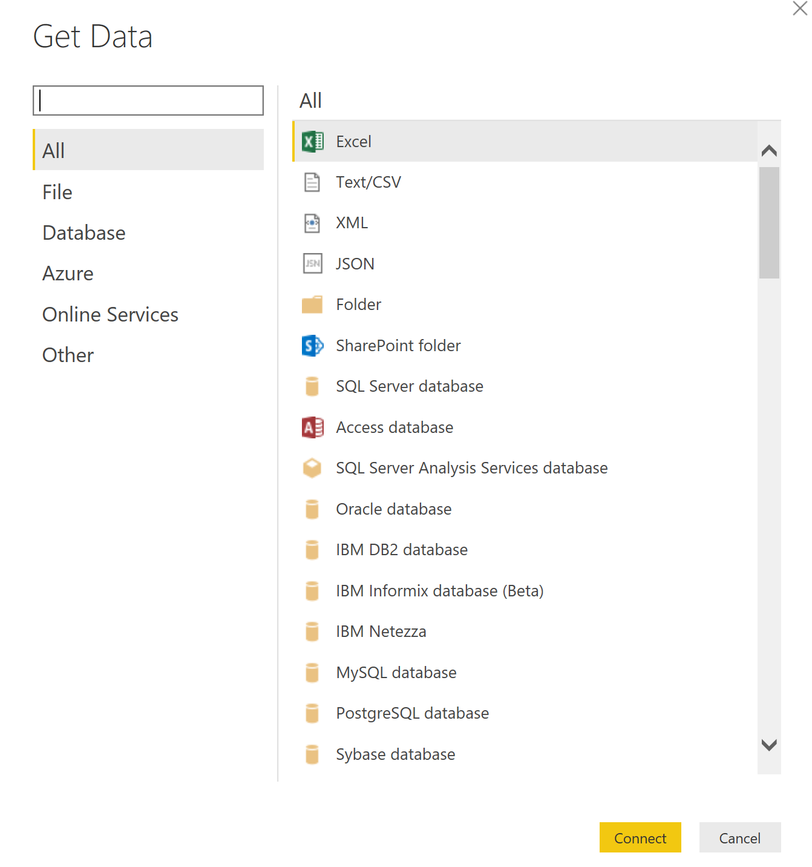
Connecting to Data Sources
Power BI offers a wide range of data sources to connect to.
Many data source connections.
On-Premise and cloud services.
Ability to do an import or direct query of the data.

Slide 25
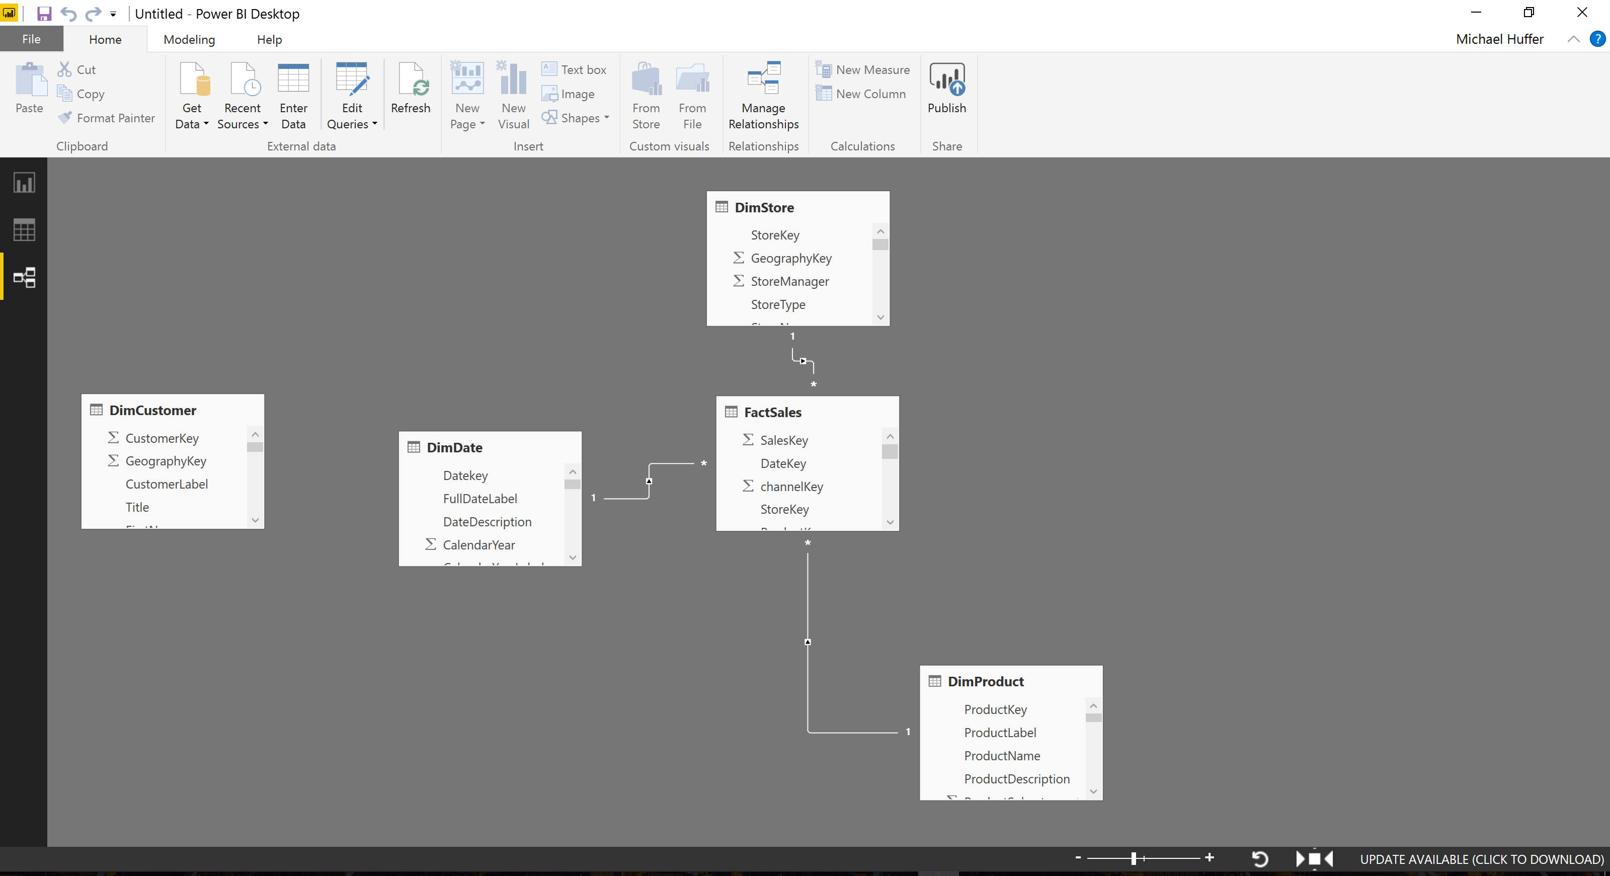
Power bi Data modeling
Create logical connections between different data sources.
Create custom calculations and view specific segments of your data.

Slide 26
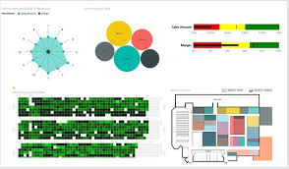
Power BI visualizations
Approximately 24 out of the box visualizations available.
Scatter plots, Bar Charts
Heatmaps, Geographical Maps
Custom Visualizations
Power BI Store
Leverage the power of R
Build your own via developer tools.

Slide 27
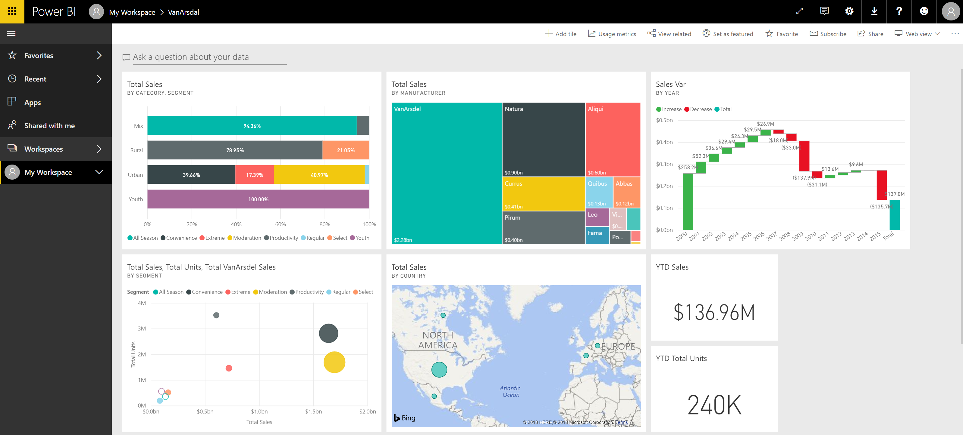
Power bi service
Available Workspaces
My Workspace
Personal workspace for a Power BI user.
App Workspaces
Collaborate and share content with others in your organization.
Notes:
Free users can only access My Workspace
You need a Pro license to collaborate and share content

Slide 28
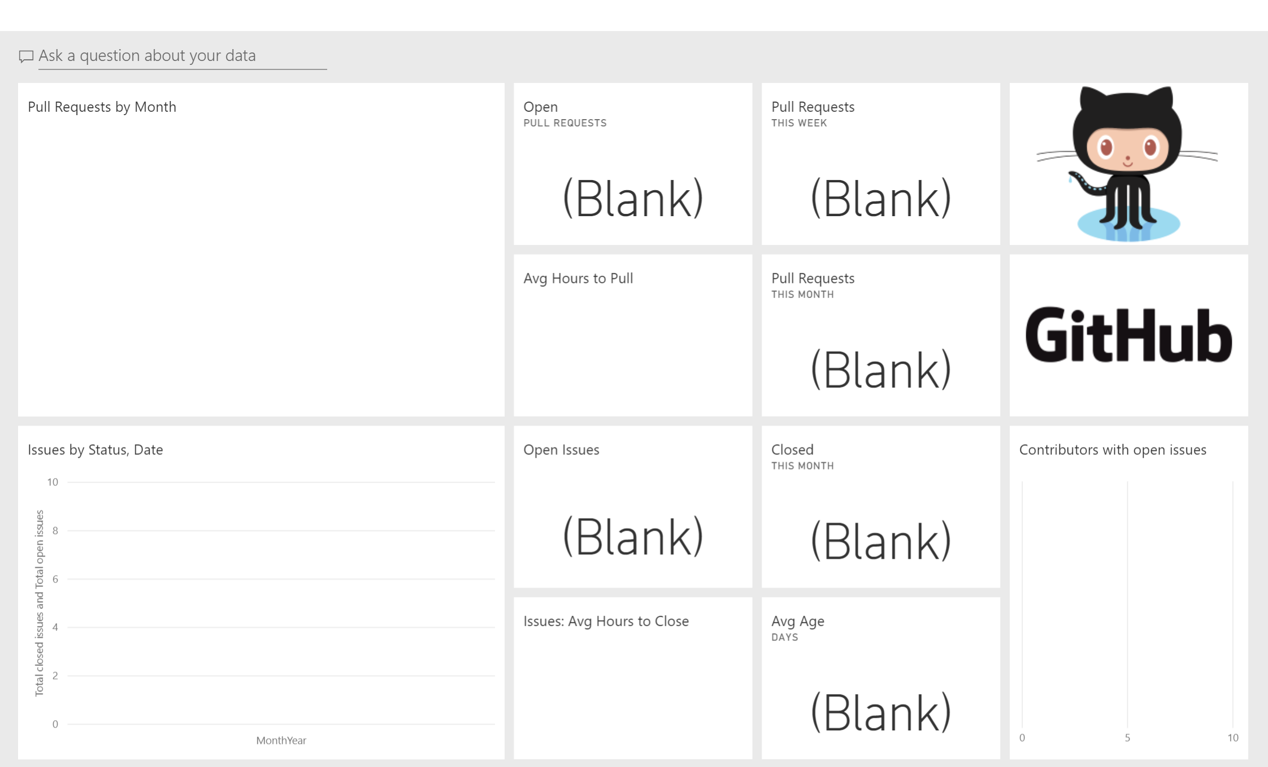
Power bi apps
A collection of dashboards and reports that are interactive but cannot be edited unless granted correct permissions.
Ability to ask questions of the dashboard or report.
Ability to access your favorite dashboards and reports from your mobile device.

Slide 29
Demo

Slide 30

Architecture
1. Prepare Data
Integrate
Harmonize
Standardize
Power BI Gateway
8. Publish Dashboard
Power BI Desktop
Power BI Service
5. Extract (ODBC)
R Script
9. Refresh
6. Call Web Service
7. Return Scored Data
4. Insert Unscored Data
2. Retrieve Dataset
Azure ML
3. Predictive models
Develop
Train
Deploy
Retrain

Slide 31
Business problem
As a Data Scientist for the Chicago Bears, you have been asked to analyze historical data to determine whether or not the opposing team will execute a run or a pass play.
You have also been asked to incorporate your model into the existing data ecosystem.
The model must leverage historical data stored in Azure SQL DB.
The model must be developed and deployed using Azure ML studio.
The model must present the predictions in the play callers existing reports leveraging Power BI.
Notes:
“As a Data Scientist for the Chicago Bears,… “

Slide 32
Links
Azure ML Experiment
https://gallery.cortanaintelligence.com/Experiment/NFL-Play-Type-Prediction
GitHub Repository
https://github.com/mdhuffer299/nfl-azureml
Email
DMI: mhuffer@dminc.com
Personal: mhuffer299@gmail.com
LinkedIn
https://www.linkedin.com/in/michael-huffer-8664086a
Data Set
https://github.com/ryurko/nflscrapR-data

Slide 33
Take aways
Azure Machine Learning Studio is a great tool to introduce predictive analytics workflow and processes to your organization.
Important to have an actionable outcome from your predictive model.
Important to explore your data and get an understanding of what data is missing and the relationships between attributes.
Important to have your dataset be reflective of the population you are exposing the model to in the future.
When you split your data it should be balanced between the train and test set.
Important to select a single metric when evaluating your machine learning model.

